Slide 1
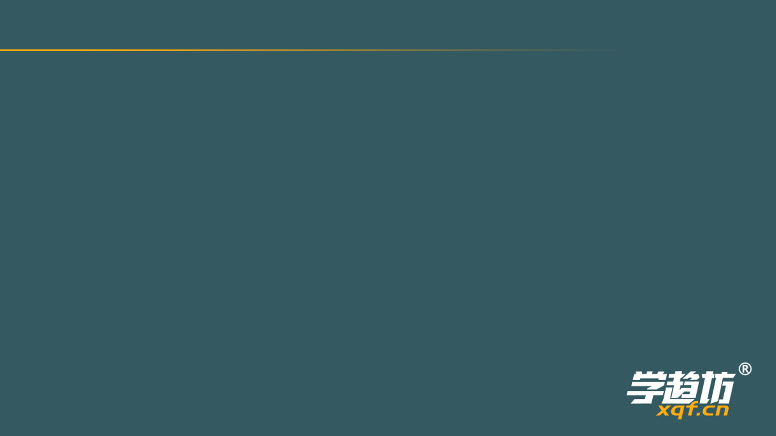
1
CECMQ2020T01

Slide 2
Which of the following underlined parts is different in pronunciation? A．ancient B．basic C．nature D．habit

Slide 3
2
CECMQ2020T02

Slide 4
The genius boy, Laurent Simons, went to ______ college at the age of twelve. А. а B. the C. an D./

Slide 5
3
CECMQ2020T03

Slide 6
Sometimes people can use body language to express more _____. A．idea B．news C．information D．message

Slide 7
4
CECMQ2020T04

Slide 8
According to experts, the first case of novel coronavinus (新冠病毒) occurred______ December 2019. A．in B．by C．at D．on

Slide 9
5
CECMQ2020T05

Slide 10
I don't like the shop assistant.______ always persuades customers to buy his products. A．He B．His C．Himself D．Him

Slide 11
6
CECMQ2020T06

Slide 12
I share my difficulties as well as happiness ______ my best friend, Linda. A．for B．to C．with D．at

Slide 13
7
CECMQ2020T07

Slide 14
Alice has read several books, but ______ of them has the information she is looking for. A．all B．both C．neither D．none

Slide 15
8
CECMQ2020T08

Slide 16
The music sounds ______ .You should turn off the radio so as not to disturb others. A．loudly B．terrible C．gently D．wonderful

Slide 17
9
CECMQ2020T09

Slide 18
At first, the virus (病毒) spread much ______ than people thought. A．fast B．faster C．fastest D．the fastest

Slide 19
10
CECMQ2020T10

Slide 20
The robot can serve customers in restaurants.______ quickly the technology develops! A．How B．What a C．What an D．What

Slide 21
11
CECMQ2020T11

Slide 22
To keep safe, the doctors ______ take all the passengers' temperature at the entrance. A．must B．can C．may D．need

Slide 23
12
CECMQ2020T12

Slide 24
The movie didn't attract many people at first, ________ it turned out to be a great success at last. A．so B．or C．but D．for

Slide 25
13
CECMQ2020T13

Slide 26
Students from other schools can't borrow books in our library ______they fill in an application card. A．if B．unless C．now that D．as soon as

Slide 27
14
CECMQ2020T14

Slide 28
The 10th China Flower Expo ______ in Chongming Island from March to July in 2021. A．was held B．will be held C．is held D．has been held

Slide 29
15
CECMQ2020T15

Slide 30
Chris ______ his seat belt before his father asked him to do so. A．fastened B．fastens C．had fastened D．will fasten

Slide 31
16
CECMQ2020T16

Slide 32
Kitty's mother often makes her ______ up early to walk the dog in their neighborhood. A．to get B．get C．getting D．got

Slide 33
17
CECMQ2020T17

Slide 34
I advised Joe to keep ______ regularly in order to lose weight. A．to exercise B．exercised C．exercises D．exercising

Slide 35
18
CECMQ2020T18

Slide 36
--______ did our class teacher praise John just now? --She praised him for his honesty. He found 500 yuan in the garden and handed it in. A. How B. What C. Where D. Why

Slide 37
19
CECMQ2020T19

Slide 38
--Thank you for looking after my pet dog for a whole week. --______ A．Not at all B．That' s very kind of you. C．No, thanks D．See you then

Slide 39
20
CECMQ2020T20

Slide 40
--______ --Come on! You can do a good job as long as you don't give up. A．I want to find a job in the company. B．I' m sorry I've made a mistake. C．I don' t think I can finish the work D．Can you tell me how to find a job?

Slide 41
21
CECMQ2020T21

Slide 42
Scientists have invented a font (字体) called Sans Forgetica. It is back-slanted (反斜的) and there are openings ineach letter. So what's the ___(01)____ of this reader--unfriendly font? In fact, Sans Forgetica is the first font which is ___(02)____to help people remember things. Its designer StevenBrian said, “The unexpected obstacles (障碍) slow your reading speed down. They make your brain work harder. It should be easier for you to remember what you are doing”Scientists have tested Sans Forgetica on 4,400 students in online ___(03)____.They said they were satisfied with the result. However. scientists say that teachers should not print all reading materials in the font. If students read everything inthis font, their brains will get too comfortable again. They will ___(04)____ignore the key points. A. experiments B. harmful C. value D. designed E. finally

Slide 43
22
CECMQ2020T22

Slide 44
We need to throw away these ______ to make room for our new furniture. (box)

Slide 45
23
CECMQ2020T23

Slide 46
This is the ______ time for me to teach you the grammar rules. (five)

Slide 47
24
CECMQ2020T24

Slide 48
While travelling in Germany, Lucy happened to meet a classmate of ______. (she)

Slide 49
25
CECMQ2020T25

Slide 50
Jack was sick in hospital because of his ______ diet. (healthy)

Slide 51
26
CECMQ2020T26

Slide 52
Success in study ______ depends on one's own efforts. (main)

Slide 53
27
CECMQ2020T27

Slide 54
During the discussion, Mrs. Brown's ______ voice deeply impressed me. (power)

Slide 55
28
CECMQ2020T28

Slide 56
We are trying to find a good ______ to deal with the environmental problems. (solve)

Slide 57
29
CECMQ2020T29

Slide 58
In the end, we all decided to ______ a charity sale for the sick people. (organization)

Slide 59
30
CECMQ2020T2102

Slide 60
Emma is a life-size doll (木偶) created by a team of health experts. They think this is what an office worker might look like in 20 years. The model is based on a ________(1) of more than 3,000 office workers in France. Germany and theUK. Nearly 50% of them are ________(2) from backache, sore eves and weight gain. All the problems are the results of sitting at a desk and looking at a computer screen all day. “If we don't make changes, these bad habits are going to make us very sick,” said William, the leader of the study. So don't let Emma become waste. Take her as a warning. We should ________(3) our posture (姿势) at the desk, and haveshort breaks from time to time during the day. Otherwise, the world could be full of Emmas in 2040. That would be ________(4) . F. improve G. horrible H. survey I. attractive J. suffering

Slide 61
31
CECMQ2020T30

Slide 62
Mike does his homework at school every day. (改为否定句) Mike ______ ______his homework at school every day.

Slide 63
32
CECMQ2020T31

Slide 64
My friend Tim has made great progress in English writing. (改为反意疑问句) My friend Tim has made great progress in English writing, ______ ______?

Slide 65
33
CECMQ2020T32

Slide 66
The first issue of our school newspaper will be published in two weeks. (对划线部分提问) ______ ______will the first issue of your school newspaper be published?

Slide 67
34
CECMQ2020T33

Slide 68
Jack was surprised to meet his relatives on a journey abroad. (保持句意不变) To______ ______, Jack met his relatives on a journey abroad

Slide 69
35
CECMQ2020T34

Slide 70
Our country sent a medical team to Italy two months ago. (改成被动语态) A medical team________ ________ to Italy two months ago.

Slide 71
36
CECMQ2020T35

Slide 72
Mr. White asked us,“Who will be responsible for the broken window?”(改为间接引语) Mr. White asked us who _______ _______ responsible for the broken window.

Slide 73
37
CECMQ2020T36

Slide 74
apologize to, the nice glass, you, for breaking, had better, him.(连词成句) ________________________________________________

Slide 75
38
CECMQ2020T37

Slide 76
Chloe Hawthorne, the owner of a famous restaurant, received a letter from her regular customer one day. After reading the letter, Ms. Hawthorne left a message to Max: Max, this is Chloe Hawthorne. I received a letter from Mr. Metcalf, one of our best customers. He complained about you in it.___(5)____ Max wrote a letter to Ms. Hawthorne. 1. Mr. and Mrs. Metcalf went to have dinner at Ms. Hawthorne's restaurant on 2. The underlined word “allocated” in Mr. Metcalf's letter probably mean “______” 3. Which of the following complaints is NOT mentioned (提到) in Mr. Metcalf's letter? A. Max didn't clear the table at all B. Max didn't serve the food carefully. C. Max talked too much to his wife D. He and his wife had to sit by the door. 4. In Mr. Metcalf's opinion, Max was a _______ waiter. 5. What might Ms. Hawthorne say to Max in the message? A. I'm really angry with you. I don't want you to work here any 1onger B. I'm really surprised at the complaint. I don't want to trust what you say. C. I'm really worried about the complaint. Tell me what happened on that night. D. I'm really pleased with your work. You are very popular among customers. 6. According to Max's letter, which of the following is NOT true? A. Max didn't clean the table as carefully as before B. Max didn't think he had caused Mrs. Metcalf to feel embarrassed. C. Mr. and Mrs. Metcalf was too late to have their table reserved (预定的) D. Max won't work in the restaurant after he apologized to Ms. Hawthorne. 19th January Dear Ms. Hawthorme I'm writing to express my disappointment with the evening my wife and I spent at yourrestaurant two nights ago. While the food was, as usual, very good. I regret (感到遗憾) toinform you that the service from our waiter, Max, was most unsatisfactory. First of all, when we arrived, we discovered our table overlooking the garden had beenallocated to some other customers. The new table we finally received was by the door andwhen I complained, Max just laughed. Furthermore, as we were sitting down, he said too much to my wife, which deeplyembarrassed her. When our meal came, he served the food carelessly and at the end clearedthe plates in an awful manner I look forward to hearing from you with a satisfactory reply Rupert Metcalf 22ad January Dear Chloe I'm really thankful that you want to listen to my side of the story. To start with. When Mr. and Mrs. Metcalf finally turned up, they were at least 45 minuteslate. That's why the table was allocated to some other customers. As for the other table by the door, I went to a lot of trouble to set it up. When they complained about it. I couldn't help laughing. But I have no reason to laugh at my customer. Another thing, this business about his wife. I only complimented (恭维) her on her dress.She didn't seem to mind. OK. I admit I forgot to clear the table the way I was supposed to I apologize if I have caused you problems, but I've been really popular at the Café. Hopeto hear from you soon. All the best. Max A. January 17th B. January 18th C. January 19th D. January 22nd A. booked B. given C. cancelled D. divided A. hardworking B. generous C. responsible D. rude

Slide 77
39
CECMQ2020T38

Slide 78
Perhaps you have heard of Peter Dinklage from the roles he hasplayed in popular TV series such as Game ofThrones (《权利的游戏》).But few know of the man behind the character and his story. His life___(1)____that a littie body can have huge energy. The famous actor, who earned three Emmy awards and a GoldenGlobe award, is just 135 cm tall. His father, mother and brother looklike ___(2)____ people. But Dinklage has been different from the otherssince his childhood. The boy was born with a common form of dwarfism (侏儒症). As a result, Peter's legs and arms stopped growing, while his head continued becoming bigger. There's no doubt that Dinklage's look was a source of trouble at first. The boy was___(3)____and bullied (欺负) by other kids. He felt lonely but he didn't look down upon himself. When hewas in the sixth grade, he played his first role in a school play. He was pleased by the audience's___(4)____ to the show. So he decided to become an actor in the future. After he graduated from high school, Dinklage entered Bennington College, where he studiedperforming arts. He ___(5)____ met several special teachers and friends who managed to help himturn his unusual look into advantage there, which made him unique (独特的). Since then, he hasacted in lots of famous films and TV series. Dinktlage has been looked as a rote model for people with dwarfism. When Dinktage wasasked in 2012 whether he saw himself as aspokesman (代言人) for the___(6)____of little people,he said, “Everyone's different. Every person's size has a different life, a different history, anddifferent ways of dealing with it. My size doesn't define (下定义) me. It's just part of who I am.” 1. A. notices B. discovers C. reports D. proves 2. A. unusual B. ordinary C. rich D. stupid 3. A. laughed at B. showed off C. picked out D. looked after 4. A. duty B. response C. excuse D. stress 5. A. luckily B. seriously C. quietly D. rarely 6. 80. A. disadvantages B. hobbies C. rights D. challenges

Slide 79
40
CECMQ2020T39

Slide 80
The Dong People(侗族人) and Their Indigo cloth(靛蓝色布) Yang Xiuying, 74, sits at wooden loom (织布机). As her fingers pass the shuttle (梭子) back and forth through the cotton threads, the old machine comes to life. Ever since she was a young girl, Yang has been making indigo cloth. “This type of handmade cloth is extremely rare. You h________(1) buy it at the market,”she said. For the Dong people in Guizhou, making indigo cloth has a long tradition. The s________(2) _has been passed down from mother to daughter over generations. Nearly every family makes its own cloth. This traditional way of making indigo cloth, unfortunately, is now in danger. It will disappear slowly in the modern industry society. Young people show little interest in it. Some of them have m________(3) _to big cities to find better jobs. Local officials want to save the tradition. They are trying to change young people's a________(4) _towards it. One program has set up several cloth-making factories in Guizhou. After learning how to make indigo cloth, young Dong people can find jobs easily. They can also work closer to home. The Dong people consider indigo cloth as i________(5) _as rice. Many Dong women spend countless hours making the cloth. They rise and start working very early in the morning. To make the cloth shiny, it must be rubbed (搓) and beaten hard. The noise of cloth being beaten often w________(6) _ the whole village up. Almost every Dong women over 40 has a tub for indigo dye (染料). The cloth has to be put in the dye for many rounds to gain the rich color. The p________(7) of coloring usually takes two weeks. Yang holds out her purple and wrinkled (有皱纹的) hands. “They say she who has the darkest hands makes the best cloth,”she says proudly.

Slide 81
41
CECMQ2020T40

Slide 82
Andrew Bennett talked for the first time about the night his wife was killed. The judge thought it was he who killed his wife. Now he wrote to a magazine from the prison about what happened on the night of November 23.1995. “I had to stay late at the hospital that night to do an operation. I left at about 11 p.m. I drove home slowly because the weather was terrible. The wind was blowing and it was raining heavily. I was turning into our road when a man suddenly ran in front of my car. I almost hit him but I stopped just in time. I was frightened and the men looked frightened, too. I got out of the car but he ran away before I could ask if he was all right. It was very strange. When I got home, the lights were on but it was very quiet. I called to my wife but there was no answer. Then I remembered that she was out at a concert.” “I was still very upset about what happened on the road. So I went to have a bath. Then I saw that the window in the bathroom was open. This was strange because my wife always locked the doors and windows before she went out. She was afraid of burglars. When I went to close it, I found Ellen lying there, blood everywhere. I rushed over and felt for her pulse but she was dead. I sat on the floor beside her body and was too frightened to do anything.” “The next thing I knew was the sky was getting bright. I can't remember a thing about that night. In the morning I phoned the police. They arrived half an hour after I phoned them. But it seemed like a few hours. During that time I tried hard to remember anything I could about the night before. I couldn't stop thinking about the man in the road. What was he doing on that night in our quiet neighborhood? Why did he look so frightened? Why did he run away?” 1. Did Andrew Bennett write the letter at home? 2. How did Andrew Bennett succeed in avoiding (避免) a traffic accident that nearly happened? 3. What didAndrew Bennett's wife want to do that night? 4. What were the two strange things that Andrew Bennett mentioned (提到)? 5. How long did it take the police to get to Andrew Bennett's house? 6. Who do you think might be the murderer (杀人犯)? Give at least two reasons.

Slide 83
42
CECMQ2020T41

Slide 84
Write a passage of at least 60 words on the topic “Online learning”(请以“在线学习”为题,写一篇不少于60个词的短文,标点符号不占格。) 提示:由于新冠病毒(novel coronavirus),前段时间我们只能在家里通过网络进行学习,有人认为很新鲜效果好,也有人觉得效果一般。请从以上两个观点中,选择一个角度,并结合自己网络学习的经历,谈谈你对“在线学习”的体会或看法，并给出理由。

